Slide 1
Ah Nam Odyssey

Slide 2
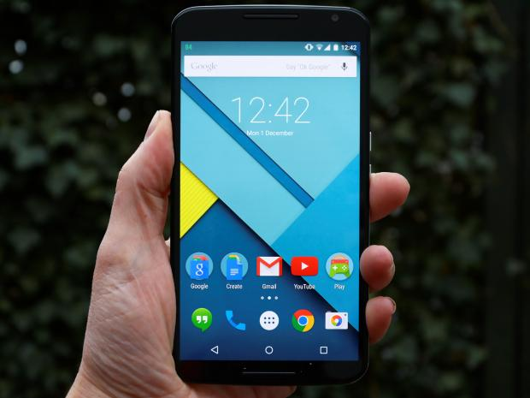




Ah |
Auto Suggest and auto list
Name DID WS No.
Ah Huang +6568877887 WSL-153
Ah Nam +6568877888 WSL-154
Ah Neo +6568877889 WSL-155
Ah Sai +6568877889 WSL-156
©CopyLeft. Acknowledgements to: Kenneth Teh, Philip Tran, Hanjin Ng

Slide 3
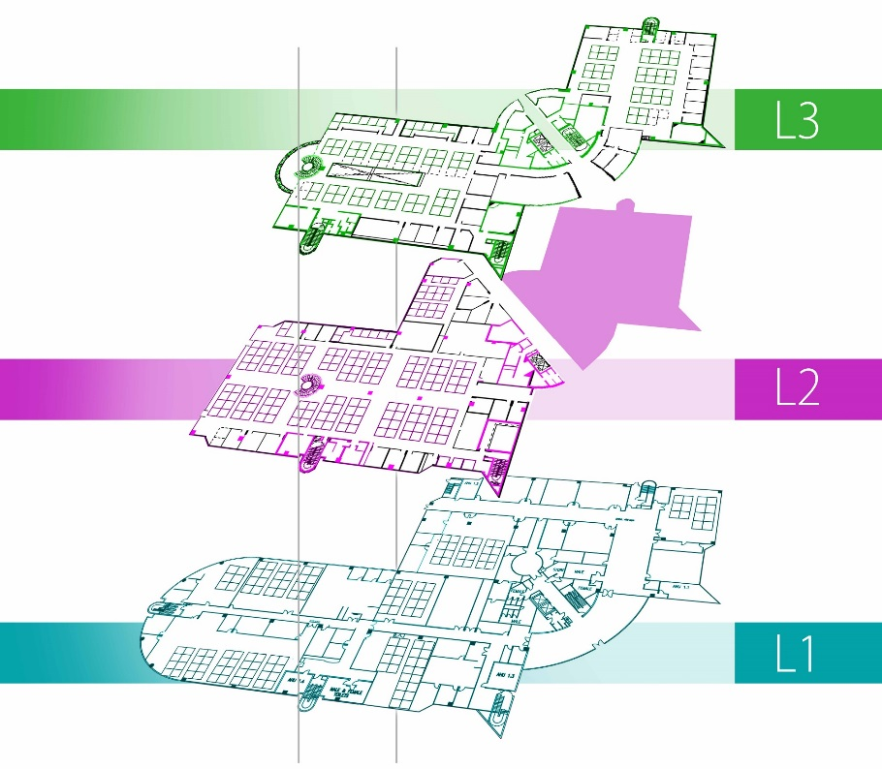
Search
Name DID WS No.
Ah Nam +6568877888 WSL-154
L1
zSG
1-04A
End-point
Reception
+
-
Pinch zoom
(in and out)
©CopyLeft. Acknowledgements to: Kenneth Teh, Philip Tran, Hanjin Ng

Slide 4
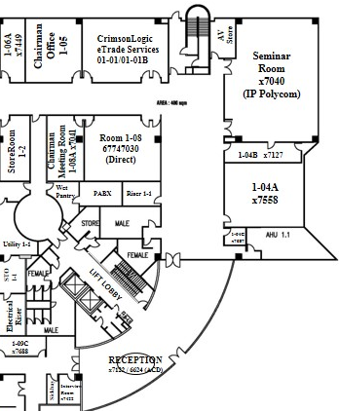
Search
Name DID WS No.
Ah Nam +6568877888 WSL-154
L1
zSG
1-04A
End-point
Reception
+
-
Pinch zoom
(in and out)
©CopyLeft. Acknowledgements to: Kenneth Teh, Philip Tran, Hanjin Ng

Slide 5
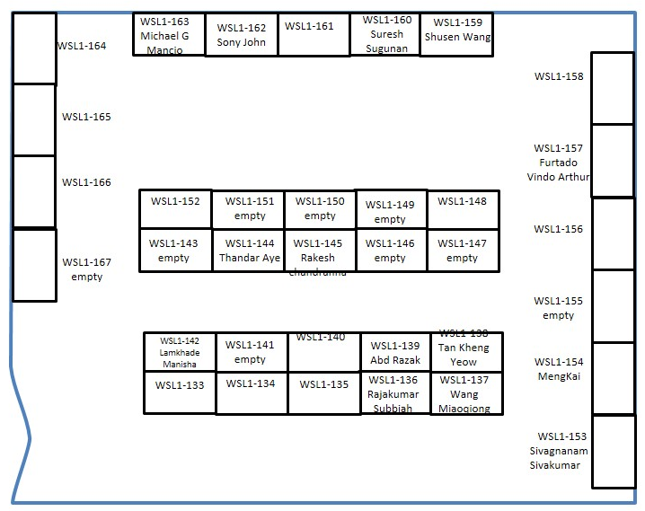


Search
Name DID WS No.
Ah Nam +6568877888 WS-154
L1
zSG
1-04A
Ah Huang
Ah Neo
Ah Nam
Show Nearby
+
-
Pinch zoom
(in and out)
©CopyLeft. Acknowledgements to: Kenneth Teh, Philip Tran, Hanjin Ng

Slide 6
Road-Map
“See his Neighbour, Make a new friend”
“21st Century Orientation”
“SOS”
Akan Datang – Coming Soon…

